Slide 1
Toxicity Report. Volume bars and PnL dynamics

Slide 2
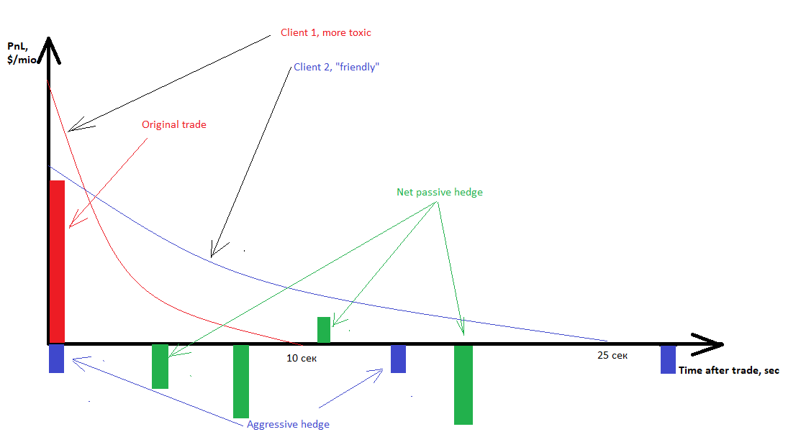
Volume bars and PL. Motivation 1
PnL from “friendly” Client2 trades on average goes to zero on 25 second after the trade relative to mid-market (at time 0 Maker earns ½ of spread)
Are we happy with Clent2’s flow? Or we should quote a little wider?
How long on average does it take to cover position from Client2 by selecting mix of aggressive and passive strategies? 30, 60, 120 seconds?

Slide 3
Volume bars and PL. Motivation 2
It’s better to cover Original trade’s volume (red bar on Slide 2) until Makers’ PnL from this trade relative to mid -market goes to negative zone
If Maker’s PnL from toxic Client1’s trade goes to negative zone much early (say, on average, after 10 seconds after the trade – red line on Slide2) than it is necessary for Maker to cover the position by finding offsetting trade and/or hedge aggressively (say, 25 seconds), then to stop losing money from Client1’s flow:
Maker could increase spread (making starting point of ½ of spread earned greater)
Maker could introduce last-looks, deals timeouts (for toxic flow during 1st second)
Does the Client1 really trade FA?
If there is no aggressive hedge or aggressive hedge is negligible (say, 1 mio in 90 seconds), then Market Impact is created by:
Client1 flow to other LPs (or there could be, for example, one big seller who sell to Client1 and other makers)
Makers’ skew
Metrics could be quantified by calculating volumes of:
Aggressive hedge;
Net client’s flow (net of buys and sell trades) that are not on Position Keeping
Volumes on the Market (for example, is volume on Moex above the average and how much?)
If all factors mentioned above taken into account, the remained is impact of skew

Slide 4
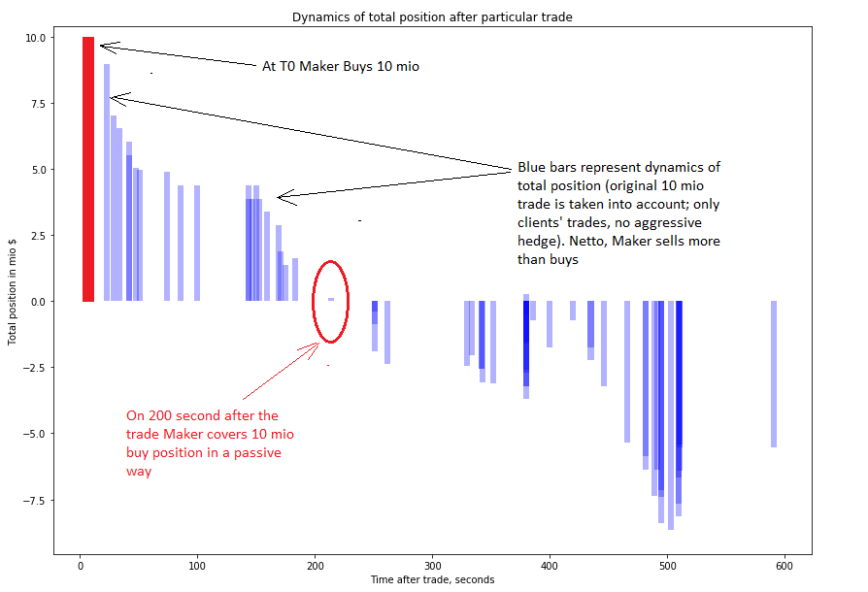
Volume bars and PL. Results 1

Slide 5
Volume bars and PL. Results 2
Python code, which:
Take list of particular clients: Client1, Client2,…
For each Client1’s trade at time T1:
Select all trades of Client1 in interval [T1; T1+delta];
Select all trades of other clients (excluding Client1) in interval [T1; T1+delta];
Calculates total volume bought/sold and how many seconds it occurs after T1;
Graph dynamics of volumes

Slide 6
Volume bars and PL. What’s next?
Integration of Volume bars to Toxicity Report PnL Profile;
Taking into account aggressive hedges;
Drawing both net buy/sell volume and total position;
Calculating time when position after the trade is close to zero (less, say, than 1 - 3 mio USD) on average for all particular Client’s trades for particular period
Filter for calculation of original trades greater than , say, X mio USD (it is interesting to see how many time it takes to cover huge usd/rub volumes greater than 10 mio)

Slide 7
Appendix
Github link to Python code: https://github.com/rrgareev/git_repo/tree/master/Volumes%20analysis;

